Slide 1




OO02: SQL Injection Attack Detection & Prevention
Progress Update – Third Meeting
GitLab Link: https://gitlab2.eeecs.qub.ac.uk/40228223/sql-injection-attack-detection-and-prevention

Slide 2
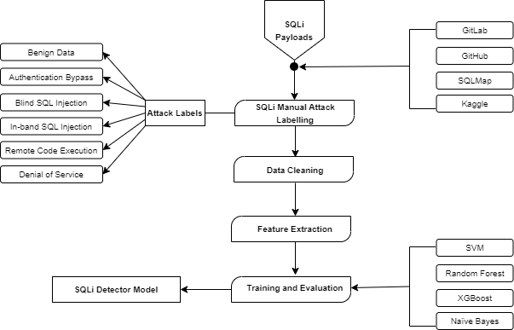
Classification and Detection Framework
Attack Labelling - Payloads were aggregated from multiple sources which include Gitlab, GitHub, SQLMap, and Kaggle.
Data Cleaning - This process involved removing empty lines and duplicate values.
Feature Extraction – FE was performed to convert the text based SQLi payload into machine readable format using Term Frequency-Inverse Document Frequency (TF-IDF) .
Training and Eval - Support Vector Machines (SVM), Random Forest (RF), XGBoost, and Naïve Bytes.

Slide 3
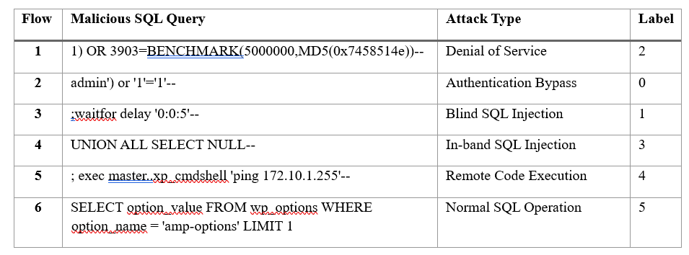
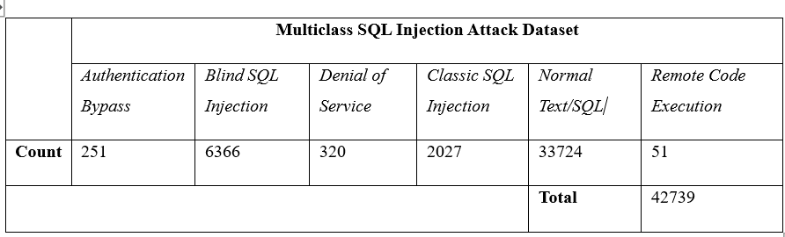
Datasets
SQLi Attack Types and Labels:
Attack Type Dataset Count:

Slide 4

ML Model Evaluation Metrics and Hyperparameter Tuning
The following calculations were performed to evaluate the performance of each machine learning model:
$$Accuracy=\frac{TP+TN}{TP+TN+FP+FN}$$
$$Precision=\frac{TP}{TP+FP}$$
$$Recall=\frac{TP}{TP+FN}$$
$$F1 Score=2 × \frac{(Precision ×Recall)}{(Precision+Recall)}$$
GridSearchCV was used to perform automated hyperparameter tuning to find the combination of classifier parameters that yields the best results.

Slide 5
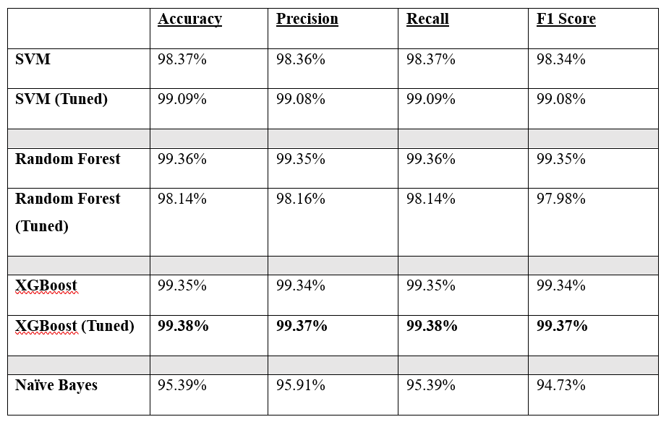
ML Model Evaluation Results
The tuned XGBoost classifier yielded the best results with an accuracy of 99.38%, precision of 99.37%, recall value of 99.38% and F1 Score of 99.37%.

